Slide 1
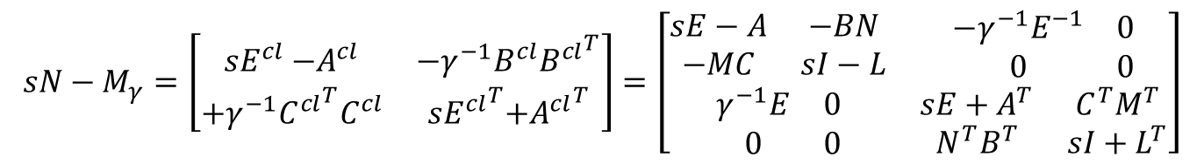
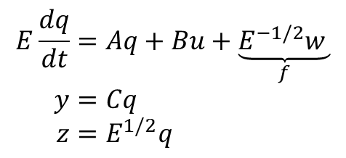
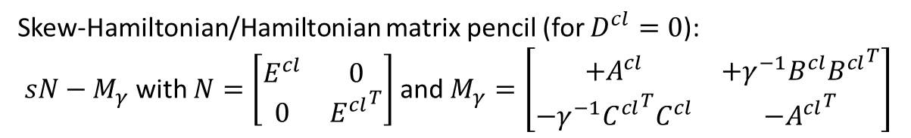

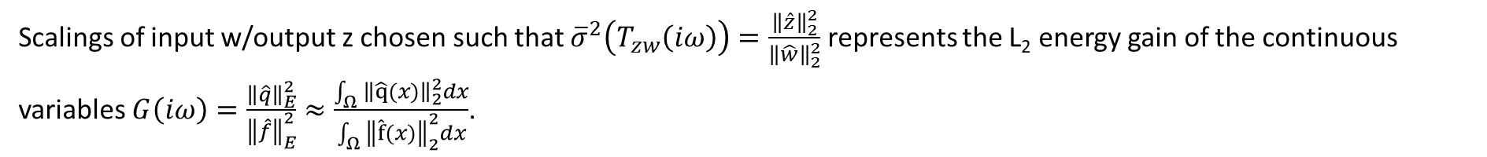
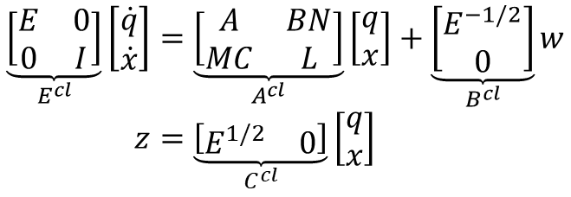
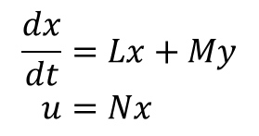
GL ($E≻0$):
$$E\frac{dq}{dt}=Aq+Bu+\underset{f}{\underbrace{E^{−1/2}w }} \\ y=Cq \\ z=E^{1/2}q$$
Contrôleur:
$$\frac{dx}{dt}=Lx+My \\ u=Nx$$
I believe Apkarian takes L tridiagonal,
but if that is not general enough we could parametrize (L,M,N) in canonical observability/controllability form
Scalings of input w/output z chosen such that ${\overline{σ}}^{2}\left(T_{zw}\left(iω\right)\right)=\frac{{\left\|\hat{z}\right\|}_{2}^{2}}{{\left\|\hat{w}\right\|}_{2}^{2}}$ represents the L₂ energy gain of the continuous variables $G\left(iω\right)=\frac{{\left\|\hat{q}\right\|}_{E}^{2}}{{\left\|\hat{f}\right\|}_{E}^{2}}≈\frac{\int_{Ω}{{\left\|\hat{q}(x)\right\|}_{2}^{2}dx}}{\int_{Ω}{{\left\|\hat{f}(x)\right\|}_{2}^{2}dx}}$.
$$\underset{E^{cl}}{\underbrace{\left[\begin{matrix}E & 0 \\ 0 & I\end{matrix}\right]}}\left[\begin{matrix}\dot{q} \\ \dot{x}\end{matrix}\right]=\underset{A^{cl}}{\underbrace{\left[\begin{matrix}A & BN \\ MC & L\end{matrix}\right]}}\left[\begin{aligned}q \\ x\end{aligned}\right]+\underset{B^{cl}}{\underbrace{\left[\begin{matrix}E^{−1/2} \\ 0\end{matrix}\right]}}w \\ z=\underset{C^{cl}}{\underbrace{\left[\begin{matrix}E^{1/2} & 0\end{matrix}\right]}}\left[\begin{aligned}q \\ x\end{aligned}\right]$$
Closed loop:
Skew-Hamiltonian/Hamiltonian matrix pencil (for $D^{cl}=0$):
$sN−M_{γ}$ with $N=\left[\begin{matrix}E^{cl} & 0 \\ 0 & {E^{cl}}^{T}\end{matrix}\right]$ and $M_{γ}=\left[\begin{matrix}{+A}^{cl} & +γ^{−1}{B^{cl}B^{cl}}^{T} \\ −γ^{−1}{C^{cl}}^{T}C^{cl} & {{−A}^{cl}}^{T}\end{matrix}\right]$
$$sN−M_{γ}=\left[\begin{matrix}{sE}^{cl}{−A}^{cl} & {−γ}^{−1}{B^{cl}B^{cl}}^{T} \\ +γ^{−1}{C^{cl}}^{T}C^{cl} & {{sE}^{cl}}^{T}{{+A}^{cl}}^{T}\end{matrix}\right]=\left[\begin{matrix}\begin{matrix}sE−A & −BN \\ −MC & sI−L\end{matrix} & \begin{matrix}−γ^{−1}E^{−1} & 0 \\ 0 & 0\end{matrix} \\ \begin{matrix}γ^{−1}E & 0 \\ 0 & 0\end{matrix} & \begin{matrix}sE+A^{T} & C^{T}M^{T} \\ N^{T}B^{T} & sI+L^{T}\end{matrix}\end{matrix}\right]$$
sparse + low rank → see next slide

Slide 2
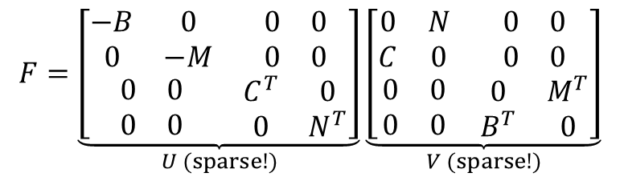
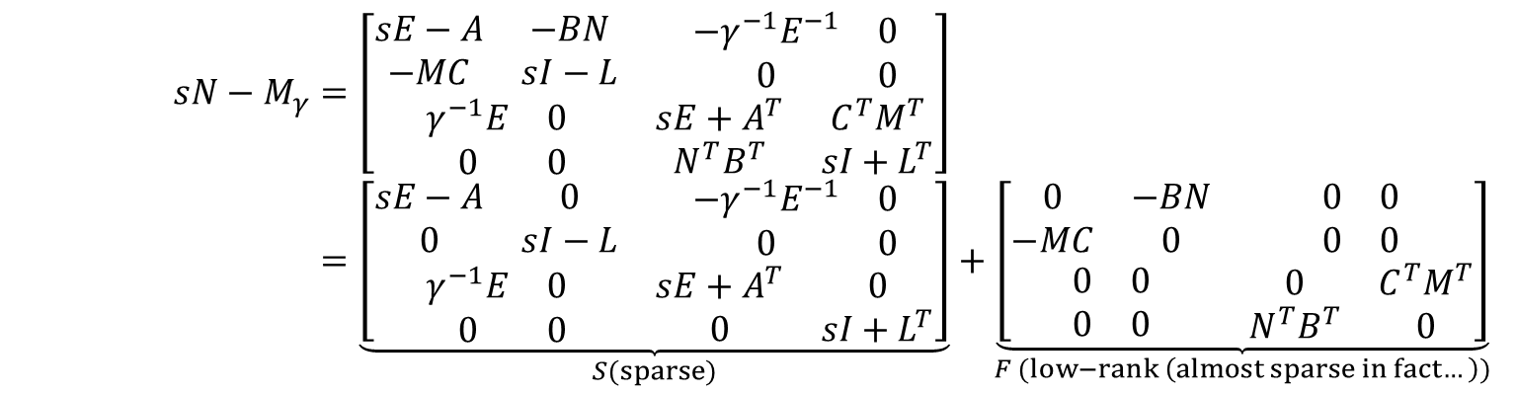

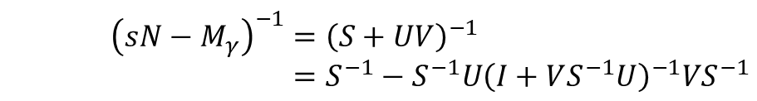
$$sN−M_{γ}=\left[\begin{matrix}\begin{matrix}sE−A & −BN \\ −MC & sI−L\end{matrix} & \begin{matrix}−γ^{−1}E^{−1} & 0 \\ 0 & 0\end{matrix} \\ \begin{matrix}γ^{−1}E & 0 \\ 0 & 0\end{matrix} & \begin{matrix}sE+A^{T} & C^{T}M^{T} \\ N^{T}B^{T} & sI+L^{T}\end{matrix}\end{matrix}\right] \\ =\underset{S(sparse)}{\underbrace{\left[\begin{matrix}\begin{matrix}sE−A & 0 \\ 0 & sI−L\end{matrix} & \begin{matrix}−γ^{−1}E^{−1} & 0 \\ 0 & 0\end{matrix} \\ \begin{matrix}γ^{−1}E & 0 \\ 0 & 0\end{matrix} & \begin{matrix}sE+A^{T} & 0 \\ 0 & sI+L^{T}\end{matrix}\end{matrix}\right]}}+\underset{F (low−rank \left(almost sparse in fact…\right))}{\underbrace{\left[\begin{matrix}\begin{matrix}0 & −BN \\ −MC & 0\end{matrix} & \begin{matrix}0 & 0 \\ 0 & 0\end{matrix} \\ \begin{matrix}0 & 0 \\ 0 & 0\end{matrix} & \begin{matrix}0 & C^{T}M^{T} \\ N^{T}B^{T} & 0\end{matrix}\end{matrix}\right]}}$$
$$F=\underset{U (sparse!)}{\underbrace{\left[\begin{matrix}\begin{matrix}−B & 0 \\ 0 & −M\end{matrix} & \begin{matrix}0 & 0 \\ 0 & 0\end{matrix} \\ \begin{matrix}0 & 0 \\ 0 & 0\end{matrix} & \begin{matrix}C^{T} & 0 \\ 0 & N^{T}\end{matrix}\end{matrix}\right]}}\underset{V (sparse!)}{\underbrace{\left[\begin{matrix}\begin{matrix}0 & N \\ C & 0\end{matrix} & \begin{matrix}0 & 0 \\ 0 & 0\end{matrix} \\ \begin{matrix}0 & 0 \\ 0 & 0\end{matrix} & \begin{matrix}0 & M^{T} \\ B^{T} & 0\end{matrix}\end{matrix}\right]}}$$
is $E^{−1}$ sparse… I don’t think so → see next slide
$${\left(sN−M_{γ}\right)}^{−1}={\left(S+UV\right)}^{−1} \\ =S^{−1}−S^{−1}U{\left(I+VS^{−1}U\right)}^{−1}VS^{−1}$$
(Woodbury’s identity)

Slide 3
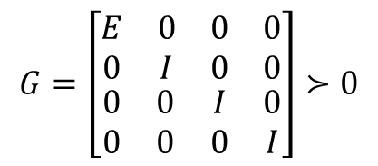
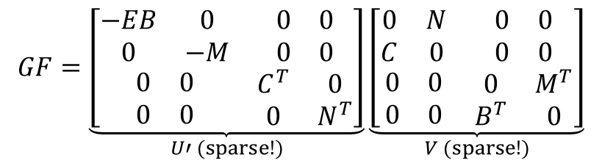
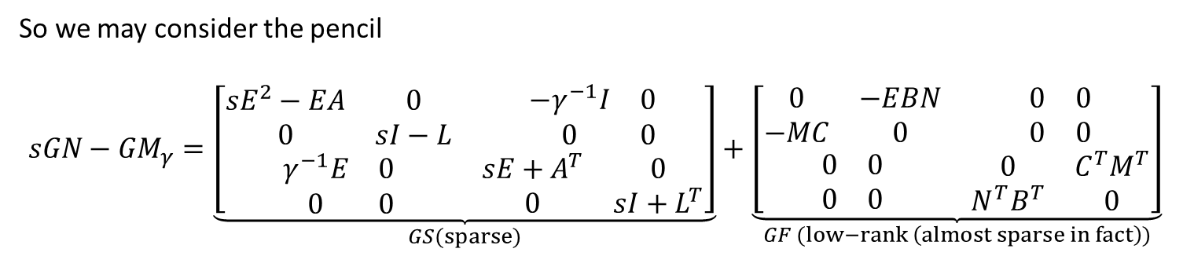
$E^{−1}$ is not sparse, but we are interested in $s$ such that $\det\left(sN−M_{γ}\right)=0$. Introduce
$$G=\left[\begin{matrix}\begin{matrix}E & 0 \\ 0 & I\end{matrix} & \begin{matrix}0 & 0 \\ 0 & 0\end{matrix} \\ \begin{matrix}0 & 0 \\ 0 & 0\end{matrix} & \begin{matrix}I & 0 \\ 0 & I\end{matrix}\end{matrix}\right]≻0$$
$$\det\left(G\left(sN−M_{γ}\right)\right)=\det\left(G\right)det⁡\left(sN−M_{γ}\right)=0⇔\det\left(sN−M_{γ}\right)=0$$
So we may consider the pencil
$$sGN−{GM}_{γ}=\underset{GS(sparse)}{\underbrace{\left[\begin{matrix}\begin{matrix}sE^{2}−EA & 0 \\ 0 & sI−L\end{matrix} & \begin{matrix}−γ^{−1}I & 0 \\ 0 & 0\end{matrix} \\ \begin{matrix}γ^{−1}E & 0 \\ 0 & 0\end{matrix} & \begin{matrix}sE+A^{T} & 0 \\ 0 & sI+L^{T}\end{matrix}\end{matrix}\right]}}+\underset{GF (low−rank \left(almost sparse in fact\right))}{\underbrace{\left[\begin{matrix}\begin{matrix}0 & −EBN \\ −MC & 0\end{matrix} & \begin{matrix}0 & 0 \\ 0 & 0\end{matrix} \\ \begin{matrix}0 & 0 \\ 0 & 0\end{matrix} & \begin{matrix}0 & C^{T}M^{T} \\ N^{T}B^{T} & 0\end{matrix}\end{matrix}\right]}}$$
$$GF=\underset{U′ (sparse!)}{\underbrace{\left[\begin{matrix}\begin{matrix}−EB & 0 \\ 0 & −M\end{matrix} & \begin{matrix}0 & 0 \\ 0 & 0\end{matrix} \\ \begin{matrix}0 & 0 \\ 0 & 0\end{matrix} & \begin{matrix}C^{T} & 0 \\ 0 & N^{T}\end{matrix}\end{matrix}\right]}}\underset{V (sparse!)}{\underbrace{\left[\begin{matrix}\begin{matrix}0 & N \\ C & 0\end{matrix} & \begin{matrix}0 & 0 \\ 0 & 0\end{matrix} \\ \begin{matrix}0 & 0 \\ 0 & 0\end{matrix} & \begin{matrix}0 & M^{T} \\ B^{T} & 0\end{matrix}\end{matrix}\right]}}$$
$${\left(sGN−{GM}_{γ}\right)}^{−1}={(GS)}^{−1}−({GS)}^{−1}U′{\left(I+V{(GS)}^{−1}U′\right)}^{−1}V{(GS)}^{−1}$$

Slide 4

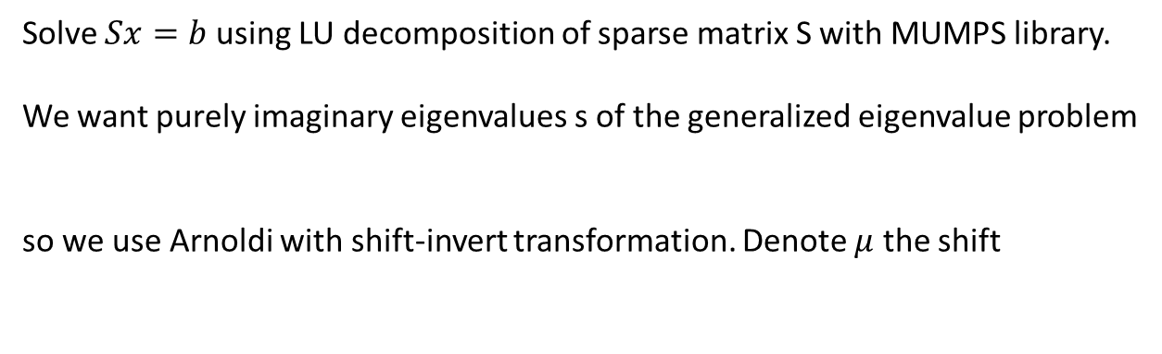
Solve $Sx=b$ using LU decomposition of sparse matrix S with MUMPS library.
We want purely imaginary eigenvalues s of the generalized eigenvalue problem
so we use Arnoldi with shift-invert transformation. Denote $μ$ the shift
$$M_{γ}z=sNz$$
$M_{γ}z=sNz⇔{(M}_{γ}−μN)z=(s−μ)Nz⇔{{(M}_{γ}−μN)}^{−1}=λNz$ with $λ=1/(s−μ)$
We use shifts $μ=iθ$ with $θ>0$ and we need to provide routines to perform $z↦Nz$ and $z↦{v={(M}_{γ}−μN)}^{−1}z$, which is equivalent to solving the linear system ${(M}_{γ}−μN)v=z$. We can use the sparse + low-rank decomposition + MUMPS with LU decomposition to do this quickly.
Do we need a spectral transformation here ? I am not sure... Check first before complicating. I do not use the same formulas as in Schwerdtner et al.’s paper.

Slide 5
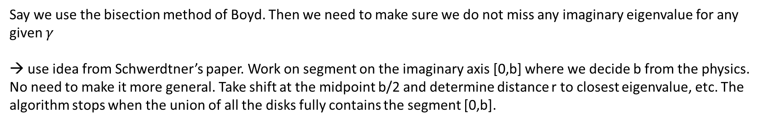
Say we use the bisection method of Boyd. Then we need to make sure we do not miss any imaginary eigenvalue for any given $γ$
→ use idea from Schwerdtner’s paper. Work on segment on the imaginary axis [0,b] where we decide b from the physics. No need to make it more general. Take shift at the midpoint b/2 and determine distance r to closest eigenvalue, etc. The algorithm stops when the union of all the disks fully contains the segment [0,b].

